Slide 1
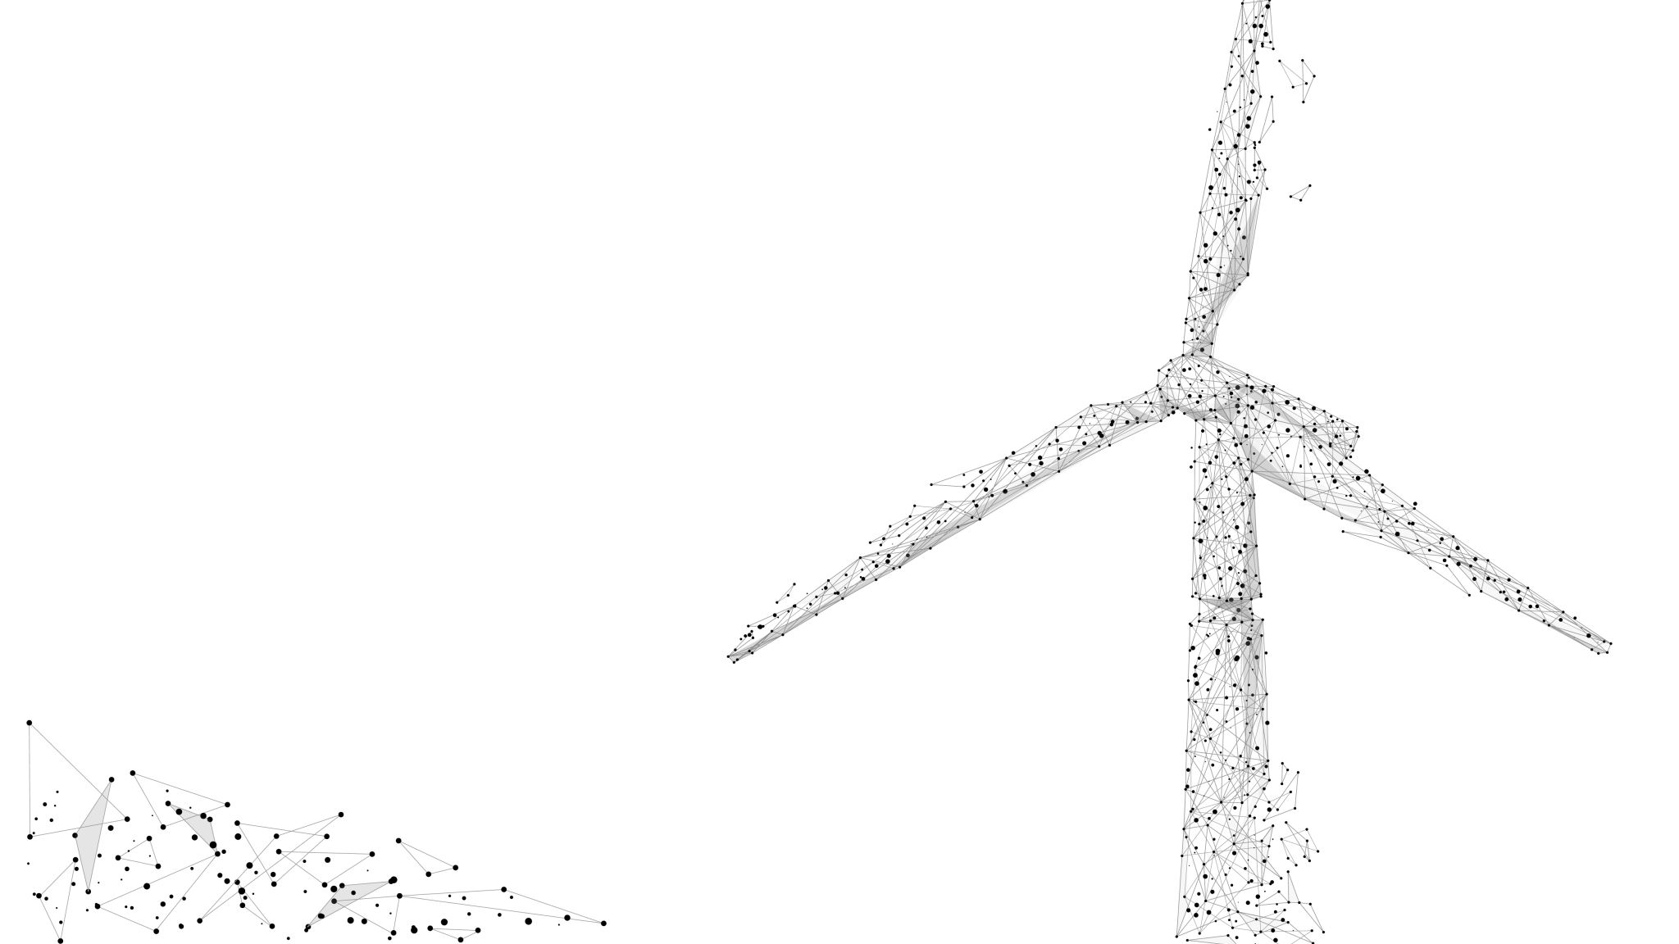
Dynamic Wind Farm Animations

Slide 2
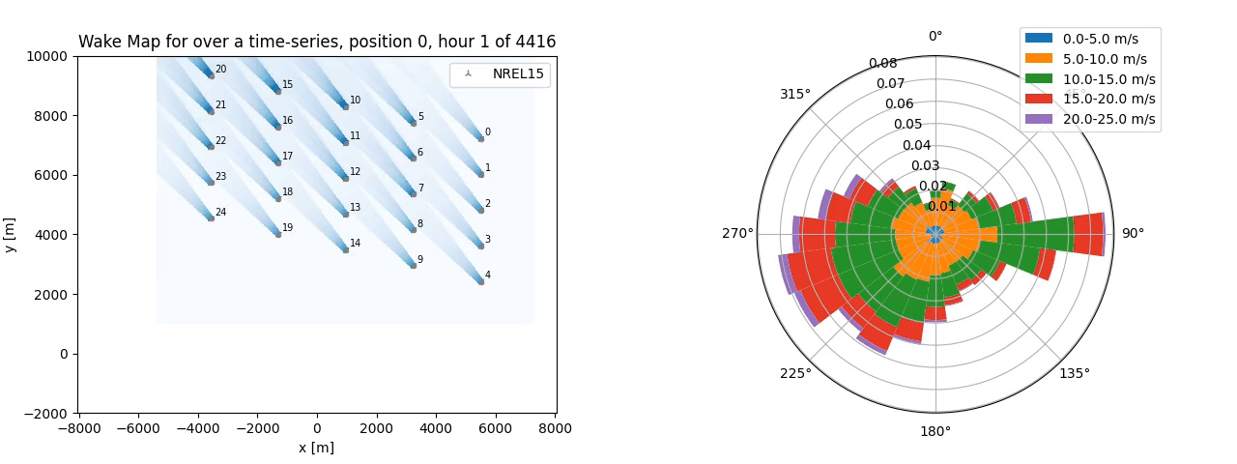
Hornsrev, High Direction Sensitivity

Slide 3

Hornsrev, Medium Direction Sensitivity

Slide 4

Hornsrev, Low Direction Sensitivity

Slide 5
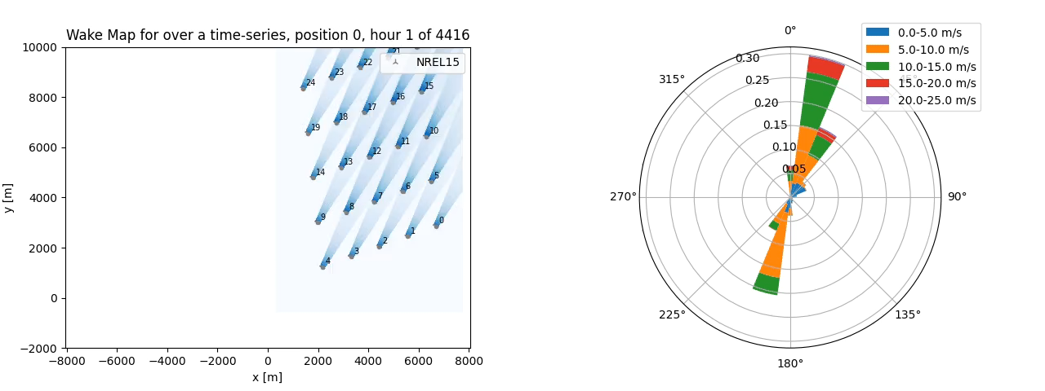
Chile, High Direction Sensitivity

Slide 6

Chile, Low Direction Sensitivity

